Slide 1













CUSTOMER SATISFACTION ANALYSIS
INVISITCO AIRLINES
VAN THONG VO
PL300-135

Slide 2
TABLE OF CONTENTS
1/ Introduction
Overview of Invistico Airlines and the survey dataset of over 130,000 customers.
2/ Customer Overview
Analysis by age, gender, travel route, ticket class, and loyalty level – identifying clear
behaviors and characteristics of each customer segment.
3/ Phân tích mức độ hài lòng
Evaluation of Pre-flight and In-flight services.
Comparison of satisfaction levels by gender and customer groups.
Analysis based on flight delays and travel distances.
4/ Giải pháp & khuyến nghị
Short-term and long-term improvement proposals tailored to customer groups and travel
routes.

Slide 3

INTRODUCTION

Slide 4

INTRODUCTION
Invistico Airlines is a simulated airline designed to reflect the operations and services of major commercial airlines.
The dataset includes survey responses from over 130,000 customers, covering:
Overall satisfaction and ratings for individual services (check-in, Wi-Fi, food, entertainment, etc.).
Personal information (age, ticket class, type of travel, loyalty level, etc.).
The goal is to gain a clear understanding of the customer experience throughout the entire journey in order to improve service quality.

Slide 5

CUSTOMER OVERVIEW

Slide 6
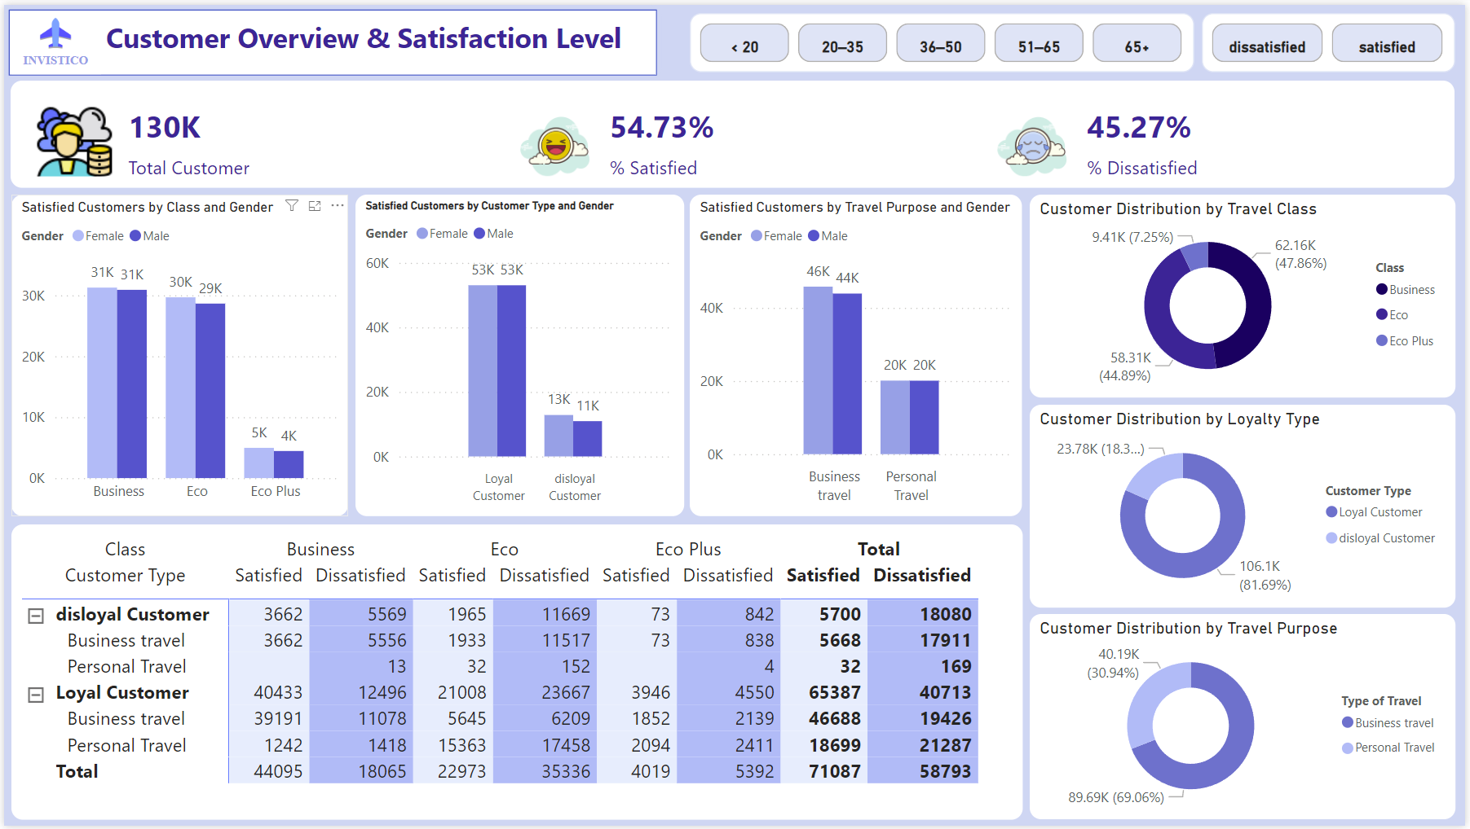

Slide 7
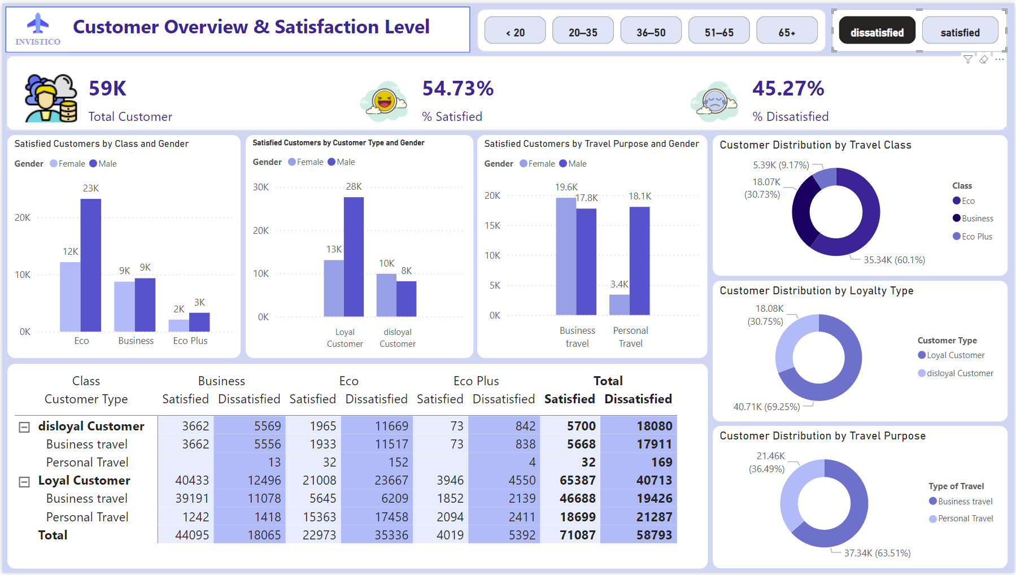

Slide 8
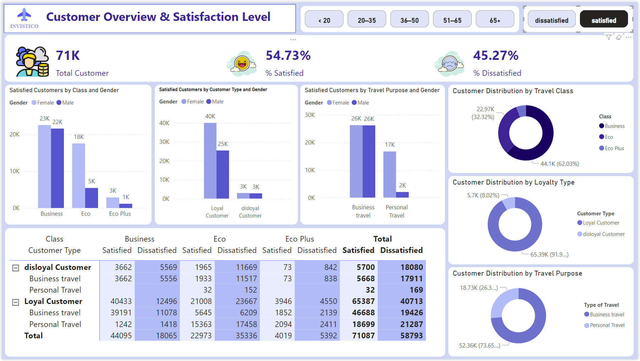

Slide 9

CUSTOMER OVERVIEW
Total Surveyed Customers: ~130,000
↳ Of these, 54.73% were satisfied, while 45.27% were dissatisfied, indicating an overall average satisfaction level.
🎯 Loyalty – Loyal vs. Disloyal Customers
Loyal Customers: Account for 81.69% of total passengers – the airline’s main customer base.
However, only 65,387 of them were satisfied, while 40,731 (≈38.37%) were dissatisfied → retaining this core group is crucial.
Disloyal Customers: Make up 18.3% of total passengers.
High dissatisfaction rate – only 5,700 out of 23,780 were satisfied.
💺 Travel Class
Business Class: 47.86%
Economy (Eco): 44.89%
Eco Plus: 7.25%
→Business and Economy combined account for 92.75% of total customers

Slide 10
CUSTOMER OVERVIEW
🧳 Travel Purpose
Business Travel: chiếm 69.06%
This group has high expectations for professionalism, speed, and punctuality.
Personal Travel: 30.94%
This group tends to be less loyal and more price- and service-sensitive.
🚻 Gender
Male and female customers are nearly evenly distributed.
Female passengers reported higher satisfaction in services like:
Online support, Seating, In-flight entertainment
However, female business travelers had a higher dissatisfaction rate than their male counterparts.
→ This suggests high expectations that were not fully met.
→ The majority of customers are loyal, travel for business, and choose either Business or Economy Class.However, there remains a significant number of dissatisfied passengers, especially:
Female business travelers
Personal travelers
Disloyal customers
→ These segments should be prioritized for experience improvement.

Slide 11
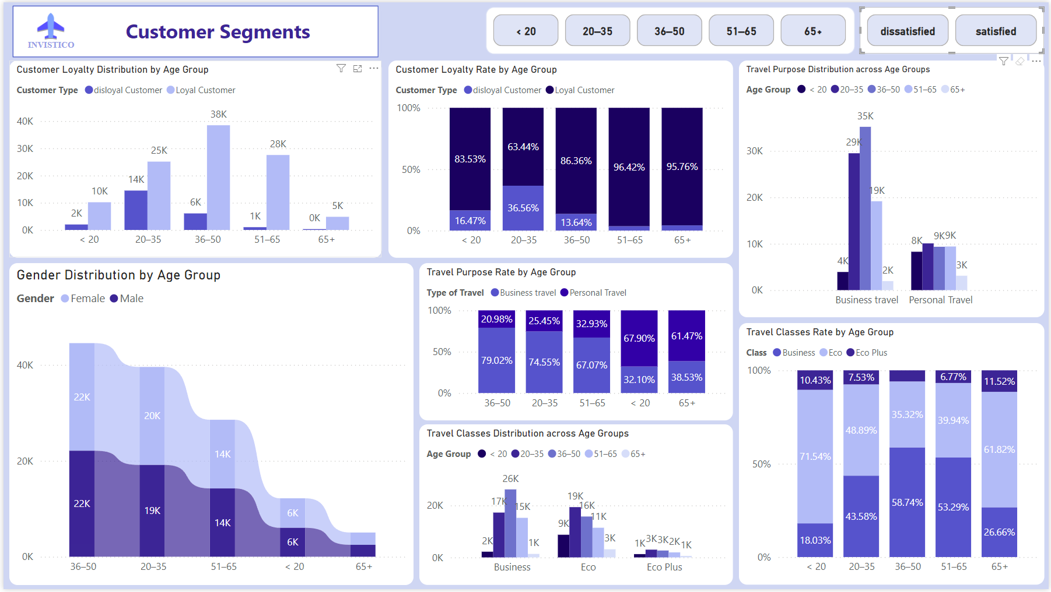

Slide 12
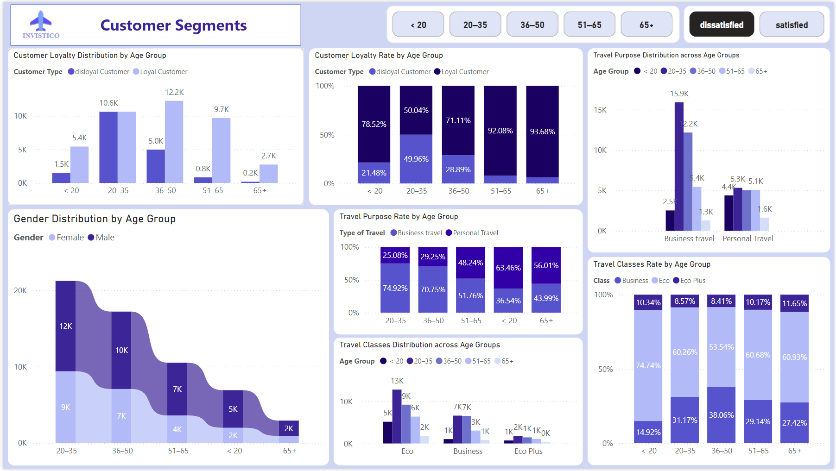

Slide 13
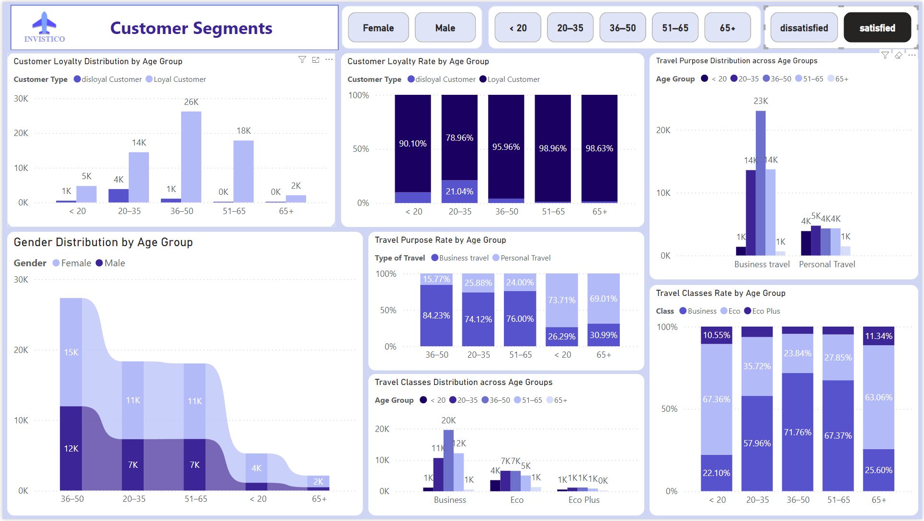

Slide 14
DISSATISFIED CUSTOMER SEGMENT
A total of 58,793 dissatisfied customers, mainly concentrated in the following groups:
Gender:
Male passengers make up a larger proportion of the dissatisfied group, especially those aged 20–50.
Female passengers generally report higher satisfaction than males in the same age ranges.
Age:
Primarily concentrated in the 20–50 age group.
Ages 20–35 have a high disloyalty rate (36.56%), despite being the second-largest customer group.
Ages 36–50 form the largest customer segment overall – though loyal, many are still dissatisfied (31.82% dissatisfaction rate).
Travel Class:
Most dissatisfied customers fly Economy Class, where basic service often fails to meet high expectations
Customer Type:
Dissatisfaction is highly concentrated among disloyal customers (18,080 out of 23,780 are dissatisfied).
However, over 40,713 loyal customers are also dissatisfied → special attention is needed to retain this core group.
Travel Purpose:
Most are Business Travelers, who typically have higher expectations and react more strongly to poor experiences.
Female business travelers are among the most dissatisfied segments.
🎯 This is the segment most at risk of churn. The airline should prioritize improving the experience for: Male customers, Economy Class passengers, Business travelers aged 20–50.

Slide 15
CUSTOMER SEGMENTATION
Notable Age Groups:
Ages 36–50: Largest segment with high loyalty (96% are loyal)
Ages 20–35: Large customer base but lower loyalty (only 50–63% loyal)
Ages 51–65 and 65+: Smaller groups but very high loyalty (~93–98%)
Under 20: Lowest loyalty (~16%), most likely to churn
Gender:
Female customers generally report higher satisfaction than males across most age groups.
However, female business travelers are among the least satisfied, indicating a need for more tailored services.
Travel Purpose:
Business Travelers: Have high loyalty but also high expectations
Personal Travelers: Show lower loyalty and are more likely to churn if dissatisfied
Personal travel is most common in the youngest (<20) and oldest (65+) age groups. These two groups have distinct behaviors and require dedicated service strategies.
Travel Class by Age Group:
Ages 36–50: Primarily choose Business and Economy, forming a significant portion of total passengers
Ages 20–35: Prefer Economy over Business → more price-sensitive and more likely to churn
Ages 51–65: Show a strong preference for Business Class → indicating higher service expectations
Under 20 and 65+: Tend to choose Economy Class

Slide 16

CUSTOMER SATISFACTION ANALYSIS

Slide 17
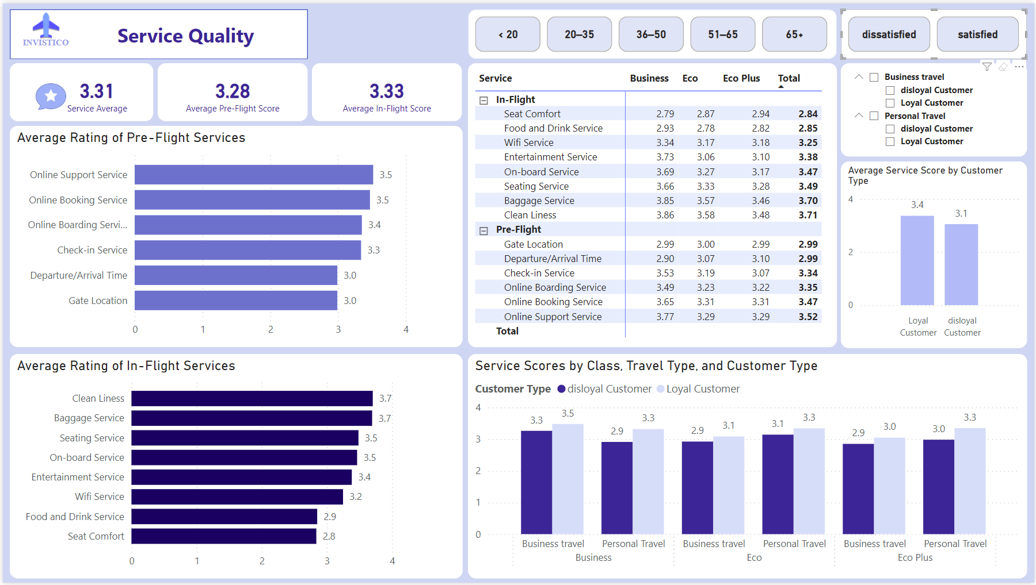

Slide 18
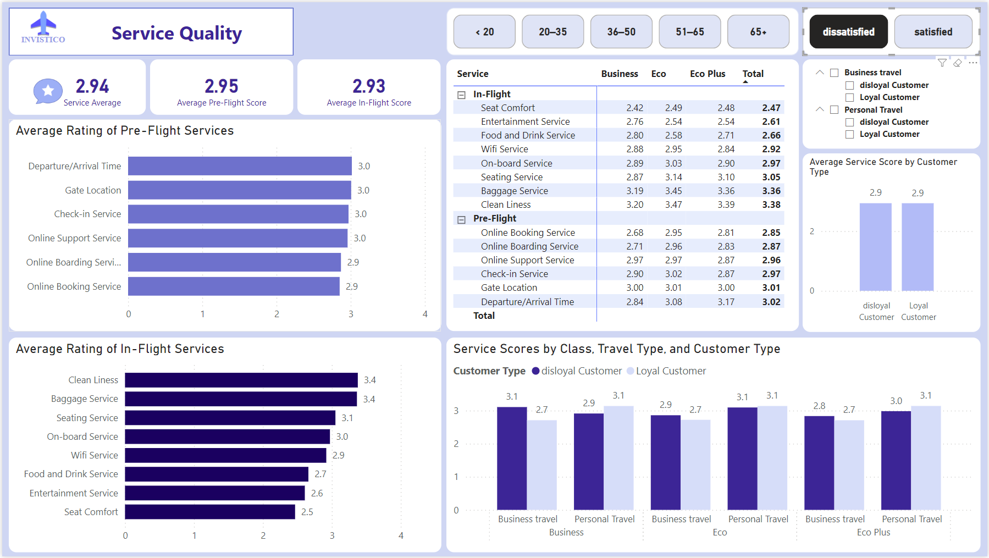

Slide 19
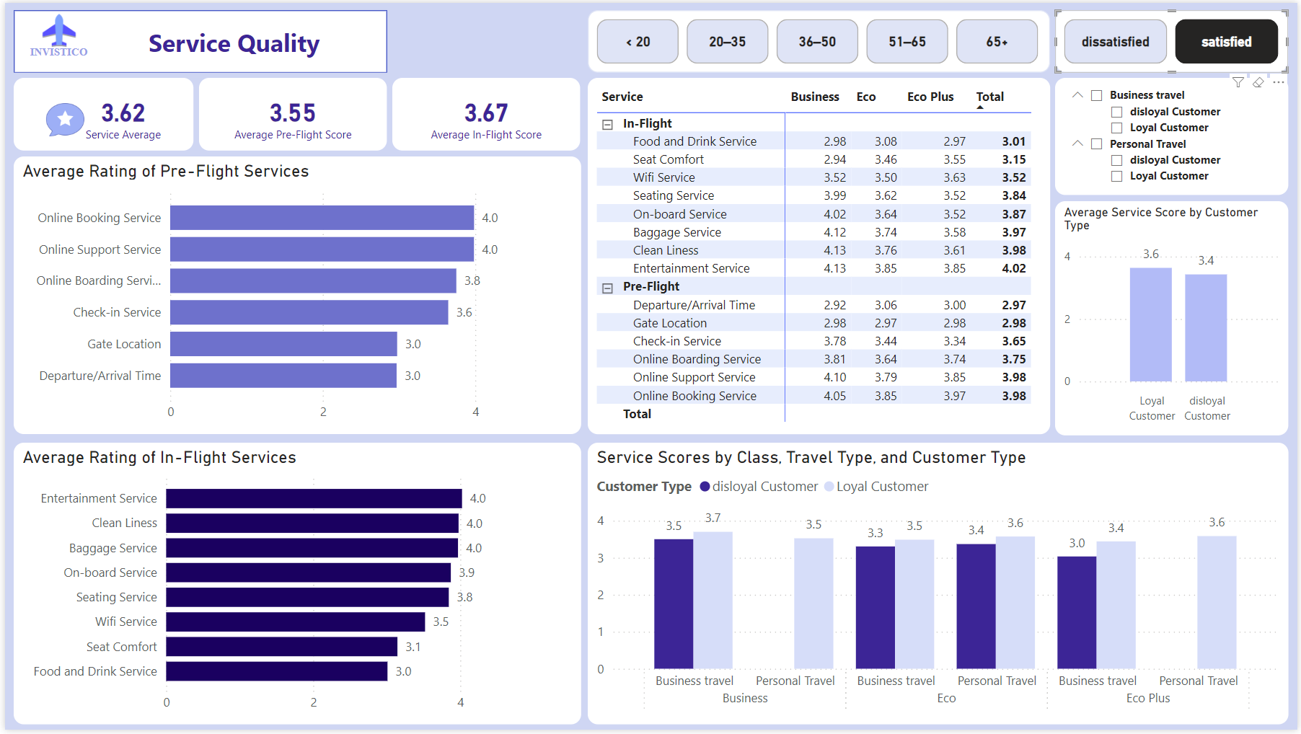

Slide 20
SERVICE RATING OVERVIEW
The average score across all services is 3.31 out of 5, indicating a moderate-to-good overall experience.
When broken down by service phase:
Pre-flight services: 3.28
In-flight services: 3.33
Although the difference is not large, the lower score for Pre-flight services suggests that initial impressions were not strong enough, which can negatively impact the overall customer experience.
Customer service
Pre-Flight
In-Flight

Slide 21


PRE-FLIGHT SERVICES
🛫 Pre-Flight Services:
Well-rated services (~3.4–3.5):
Online Support (3.5): Fast and effective customer assistance.
Online Booking (3.5): Easy-to-use ticket reservation system.
Online Boarding (3.4): Convenient electronic boarding process.
Services needing improvement (~3.0):
Airport Check-in (3.3): Time-consuming, with limited staff support.
Gate Location (3.0): Difficult to locate gates; frequent changes cause confusion.
Departure/Arrival Time (3.0): Delays and untimely updates, especially affecting business travelers.
Average Pre-Flight satisfaction score:
Dissatisfied customers: 2.95
Satisfied customers: 3.55
→ This large gap highlights Pre-Flight services as a key area for improvement.

Slide 22
IN-FLIGHT SERVICES
Top-rated services (~3.5–3.7):
Cleanliness (3.7): Clean cabins with consistent standards across all ticket classes.
Baggage Handling (3.7): Efficient baggage processing, minimal lost luggage.
On-board Service (3.5): Friendly and professional cabin crew.
Moderately rated services (~3.2–3.4):
Seating (3.5): Comfortable in Business Class, but limited space in Economy.
Entertainment (3.4): Acceptable content, but lacking in variety.
Wi-Fi (3.2): Unstable connection, negatively impacting the experience.
Lowest-rated services (~2.8–2.9):
Food & Drink (2.9): Limited options and poor quality.
Seat Comfort (2.8): Especially low in Economy Class – cramped and not suitable for resting.
Average In-flight satisfaction score:
Dissatisfied customers: 2.93
Satisfied customers: 3.67
→ This significant gap reflects major issues in basic services like seating and food, which need urgent attention.

Slide 23
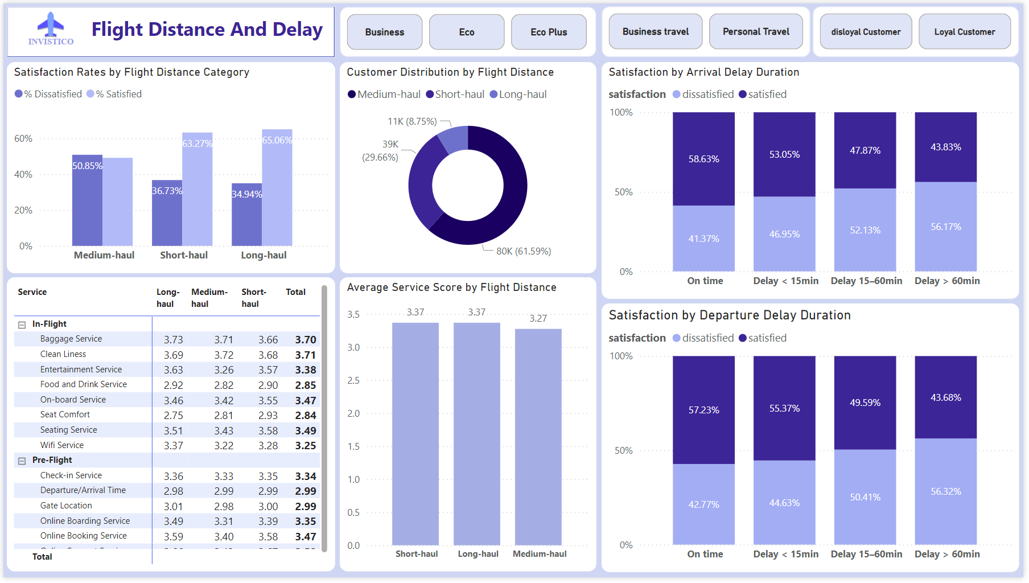

Slide 24
FLIGHT DISTANCE & SATISFACTION ANALYSIS
Flight distance has a clear impact on customer satisfaction:
Medium-haul flights show the highest dissatisfaction rate:
Only 49.15% satisfied
50.85% dissatisfied
→ Indicates subpar experience and should be prioritized for improvement.
In contrast, both Short-haul and Long-haul flights have higher satisfaction rates:
Short-haul: 63.27% satisfied
Long-haul: 65.06% satisfied
→ These routes tend to deliver experiences aligned with expectations.
However, Medium-haul flights account for 61.59% of all passengers, meaning they have a major influence on overall satisfaction.
Customer service
Pre-Flight
In-Flight

Slide 25
FLIGHT DISTANCE & SATISFACTION ANALYSIS
Flight delays have a clear negative impact on customer satisfaction, especially for extended delays.
📉 The longer the delay, the higher the dissatisfaction:
Delays > 60 minutes – Highest dissatisfaction rates:
Departure: 56.32% dissatisfied
Arrival: 56.17% dissatisfied
Delays between 15–60 minutes – Noticeable increase in dissatisfaction:
Departure: 50.41% dissatisfied
Arrival: 52.13% dissatisfied
Delays < 15 minutes – Lower, but still significant dissatisfaction:
Departure: 44.63% dissatisfied
Arrival: 46.95% dissatisfied
On-time performance does not guarantee satisfaction:
Even when flights departed on time, 42.77% of customers were still dissatisfied.
→ This suggests that service quality (e.g., boarding process, cabin environment, seat comfort) may still fall short of expectations.
👉 Flight delays, especially those over 15 minutes, have a strong negative impact on the overall customer experience. However, being on time alone is not enough, airlines must also deliver service quality that matches expectations to truly improve satisfaction.
Customer service
Pre-Flight
In-Flight

Slide 26

SOLUTIONS & RECOMMENDATIONS

Slide 27
SOLUTIONS & RECOMMENDATIONS
📌 Short-term – Immediate Improvements:
🪑 Seat Comfort:
Upgrade seat width, recline angle, and cushioning, especially in Economy Class, which currently receives the lowest rating (2.8/5) and significantly affects the overall experience.
🍱 Food & Drink:
Improve quality and menu variety, and ensure timely service. This category currently has the lowest satisfaction score across all services (~2.9/5).
🛫 Check-in & Gate Announcements:
Reduce waiting time by:
Adding more check-in counters.
Increasing staff availability for on-site support.
Enhancing digital displays for clearer, real-time updates on boarding gates and flight times.
🕒 More Professional Delay Handling:
Send notifications via app/email/SMS for delays exceeding 15 minutes.
Offer free water or food vouchers for longer delays.
Note: Even on-time flights can cause dissatisfaction if the service is poor → Consistency in service quality is key.

Slide 28
SOLUTIONS & RECOMMENDATIONS
📌 Long-term – Sustainable Strategies:
🎯Service Personalization: Segment customers (e.g., business travelers, leisure travelers, seniors) and tailor experiences based on their needs:
Priority boarding.
Pre-selected seating.
Age-appropriate entertainment.
📊 Power BI & Early Warning System Integration:
Monitor real-time satisfaction metrics across service touchpoints.
Implement early alerts to detect and respond to service quality drops promptly.
🧠 Re-train Frontline Staff (In-flight & Ground): Focus training on:
Friendly and empathetic communication.
Clear instructions and assistance.
Understanding customer psychology during delays.
🧭 Focus on Loyal Customers:
31.82% of loyal customers are still dissatisfied → this group poses the highest churn risk.
Prioritize retention through:
Exclusive service perks
Faster, more responsive feedback systems

Slide 29
THANK YOU
Van Thong Vo

